Slide 1
雲端計算
Cloud Computing
Lab–Hadoop

Slide 2
Agenda
Hadoop Introduction
HDFS
MapReduce Programming Model
Hbase

Slide 3

Hadoop
Hadoop is
  An Apache project
  A distributed computing platform
  A software framework that lets one easily write and run applications that process vast amounts of data
Cloud Applications
MapReduce
Hbase
Hadoop Distributed File System (HDFS)
A Cluster of Machines

Slide 4
History (2002-2004)
Founder of Hadoop – Doug Cutting
Lucene
  A high-performance, full-featured text search engine library written entirely in Java
  An inverse index of every word in different documents
Nutch
  Open source web-search software
  Builds on Lucene library

Slide 5
History (Turning Point)
Nutch encountered the storage predicament
Google published the design of web-search engine
  SOSP 2003 : “The Google File System”
  OSDI 2004 : “MapReduce : Simplifed Data Processing on Large Cluster”
  OSDI 2006 : “Bigtable: A Distributed Storage System for Structured Data”

Slide 6
History (2004-Now)
Dong Cutting refers to Google's publications
  Implemented GFS & MapReduce into Nutch
Hadoop has become a separated project since Nutch 0.8
  Yahoo hired Dong Cutting to build a team of web search engine
Nutch DFS → Hadoop Distributed File System (HDFS)

Slide 7
Hadoop Features
Efficiency
  Process in parallel on the nodes where the data is located
Robustness
  Automatically maintain multiple copies of data and automatically re-deploys computing tasks based on failures
Cost Efficiency
  Distribute the data and processing across clusters of commodity computers
Scalability
  Reliably store and process massive data

Slide 8
Google vs. Hadoop
Develop Group | Google | Apache
Sponsor | Google | Yahoo, Amazon
Resource | open document | open source
Programming Model | MapReduce | Hadoop MapReduce
File System | GFS | HDFS
Storage System (for structure data) | Bigtable | Hbase
Search Engine | Google | Nutch
OS | Linux | Linux / GPL

Slide 9
HDFS
HDFS Introduction
HDFS Operations
Programming Environment
Lab Requirement

Slide 10
What’s HDFS
Hadoop Distributed File System
Reference from Google File System
A scalable distributed file system for large data analysis
Based on commodity hardware with high fault-tolerant
The primary storage used by Hadoop applications
Cloud Applications
MapReduce
Hbase
Hadoop Distributed File System (HDFS)
A Cluster of Machines

Slide 11
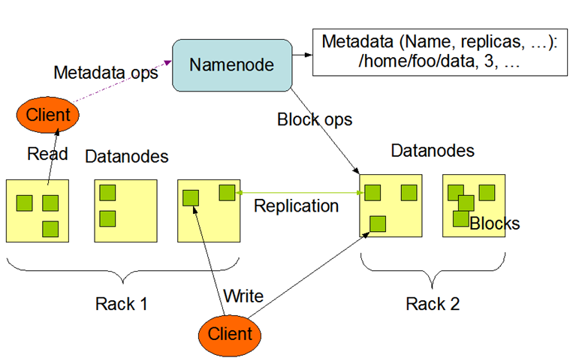
HDFS Architecture
HDFS Architecture

Slide 12
HDFS Client Block Diagram
Client computer
HDFS Namenode
HDFS-Aware application
POSIX API
HDFS API
HDFS Datanode
Regular VFS with local and NFS-supported files
Separate HDFS view
Specific drivers
Network stack
HDFS Datanode

Slide 13
HDFS
HDFS Introduction
HDFS Operations
Programming Environment
Lab Requirement

Slide 14
HDFS operations
Shell Commands
HDFS Common APIs

Slide 15
HDFS Shell Command(1/2)
Command | Operation
-ls path | Lists the contents of the directory specified by path, showing the names, permissions, owner, size and modification date for each entry.
-lsr path | Behaves like -ls, but recursively displays entries in all subdirectories of path.
-du path | Shows disk usage, in bytes, for all files which match path; filenames are reported with the full HDFS protocol prefix.
-mv src dest | Moves the file or directory indicated by src to dest, within HDFS.
-cp src dest | Copies the file or directory identified by src to dest, within HDFS.
-rm path | Removes the file or empty directory identified by path.
-rmr path | Removes the file or directory identified by path. Recursively deletes any child entries (i.e., files or subdirectories of path).
-put localSrc dest | Copies the file or directory from the local file system identified by localSrc to dest within the DFS.
-copyFromLocal localSrc dest | Identical to -put
-moveFromLocal localSrc dest | Copies the file or directory from the local file system identified by localSrc to dest within HDFS, then deletes the local copy on success.
-get [-crc] src localDest | Copies the file or directory in HDFS identified by src to the local file system path identified by localDest.

Slide 16
HDFS Shell Command(2/2)
Command | Operation
-copyToLocal [-crc] src localDest | Identical to -get
-moveToLocal [-crc] src localDest | Works like -get, but deletes the HDFS copy on success.
-cat filename | Displays the contents of filename on stdout.
-mkdir path | Creates a directory named path in HDFS. Creates any parent directories in path that are missing (e.g., like mkdir -p in Linux).
-test -[ezd] path | Returns 1 if path exists; has zero length; or is a directory, or 0 otherwise.
-stat [format] path | Prints information about path. format is a string which accepts file size in blocks (%b), filename (%n), block size (%o), replication (%r), and modification date (%y, %Y).
-tail [-f] file | Shows the lats 1KB of file on stdout.
-chmod [-R] mode,mode,... path... | Changes the file permissions associated with one or more objects identified by path.... Performs changes recursively with -R. mode is a 3-digit octal mode, or {augo}+/-{rwxX}. Assumes a if no scope is specified and does not apply a umask.
-chown [-R] [owner][:[group]] path... | Sets the owning user and/or group for files or directories identified by path.... Sets owner recursively if -R is specified.
-help cmd | Returns usage information for one of the commands listed above. You must omit the leading '-' character in cmd

Slide 17
For example
In the <HADOOP_HOME>/
  bin/hadoop fs –ls
    Lists the content of the directory by given path of HDFS
  ls
    Lists the content of the directory by given path of local file system

Slide 18
HDFS Common APIs
Configuration
FileSystem
Path
FSDataInputStream
FSDataOutputStream

Slide 19
Using HDFS Programmatically(1/2)
1: import java.io.File;
2: import java.io.IOException;
3:
4: import org.apache.hadoop.conf.Configuration;
5: import org.apache.hadoop.fs.FileSystem;
6: import org.apache.hadoop.fs.FSDataInputStream;
7: import org.apache.hadoop.fs.FSDataOutputStream;
8: import org.apache.hadoop.fs.Path;
9:
10: public class HelloHDFS {
11:
12: public static final String theFilename = "hello.txt";
13: public static final String message = “Hello HDFS!\n";
14:
15: public static void main (String [] args) throws IOException {
16:
17: Configuration conf = new Configuration();
18: FileSystem hdfs = FileSystem.get(conf);
19:
20: Path filenamePath = new Path(theFilename);

Slide 20
Using HDFS Programmatically(2/2)
21:
22: try {
23: if (hdfs.exists(filenamePath)) {
24: // remove the file first
25: hdfs.delete(filenamePath, true);
26: }
27:
28: FSDataOutputStream out = hdfs.create(filenamePath);
29: out.writeUTF(message);
30: out.close();
31:
32: FSDataInputStream in = hdfs.open(filenamePath);
33: String messageIn = in.readUTF();
34: System.out.print(messageIn);
35: in.close();
36: } catch (IOException ioe) {
37: System.err.println("IOException during operation: " + ioe.toString());
38: System.exit(1);
39: }
40: }
41: }
FSDataOutputStream extends the java.io.DataOutputStream class
FSDataInputStream extends the java.io.DataInputStream class

Slide 21
Configuration
Provides access to configuration parameters.
  Configuration conf = new Configuration()
    A new configuration.
  … = new Configuration(Configuration other)
    A new configuration with the same settings cloned from another.
Methods:
Return type | Function | Parameter
void | addResource | (Path file)
void | clear | ( )
String | get | (String name)
void | set | (String name, String value)

Slide 22
FileSystem
An abstract base class for a fairly generic FileSystem.
Ex:
Methods:
Configuration conf = new Configuration();
FileSystem hdfs = FileSystem.get( conf );
Return type | Function | Parameter
void | copyFromLocalFile | (Path src, Path dst)
void | copyToLocalFile | (Path src, Path dst)
Static FileSystem | get | (Configuration conf)
boolean | exists | (Path f)
FSDataInputStream | open | (Path f)
FSDataOutputStream | create | (Path f)

Slide 23
Path
Names a file or directory in a FileSystem.
Ex:
Methods:
Path filenamePath = new Path(“hello.txt”);
Return type | Function | Parameter
int | depth | ( )
FileSystem | getFileSystem | (Configuration conf)
String | toString | ( )
boolean | isAbsolute | ( )

Slide 24
FSDataInputStream
Utility that wraps a FSInputStream in a DataInputStream and buffers input through a BufferedInputStream.
Inherit from java.io.DataInputStream
Ex:
Methods:
FSDataInputStream in = hdfs.open(filenamePath);
Return type | Function | Parameter
long | getPos | ( )
String | readUTF | ( )
void | close | ( )

Slide 25
FSDataOutputStream
Utility that wraps a OutputStream in a DataOutputStream, buffers output through a BufferedOutputStream and creates a checksum file.
Inherit from java.io.DataOutputStream
Ex:
Methods:
FSDataOutputStream out = hdfs.create(filenamePath);
Return type | Function | Parameter
long | getPos | ( )
void | writeUTF | (String str)
void | close | ( )

Slide 26
HDFS
HDFS Introduction
HDFS Operations
Programming Environment
Lab Requirement

Slide 27
Environment
A Linux environment
  On physical or virtual machine
  Ubuntu 10.04
Hadoop environment
  Reference Hadoop setup guide
  user/group: hadoop/hadoop
  Single or multiple node(s), the later is preferred.
Eclipse 3.7M2a with hadoop-0.20.2 plugin

Slide 28
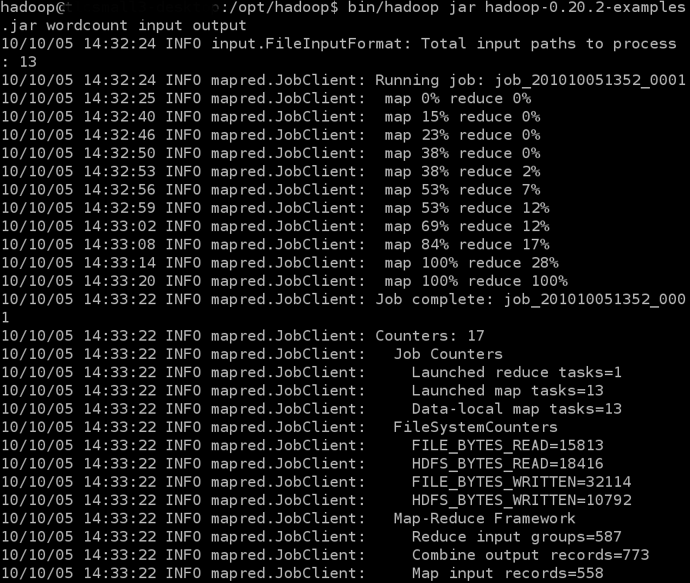
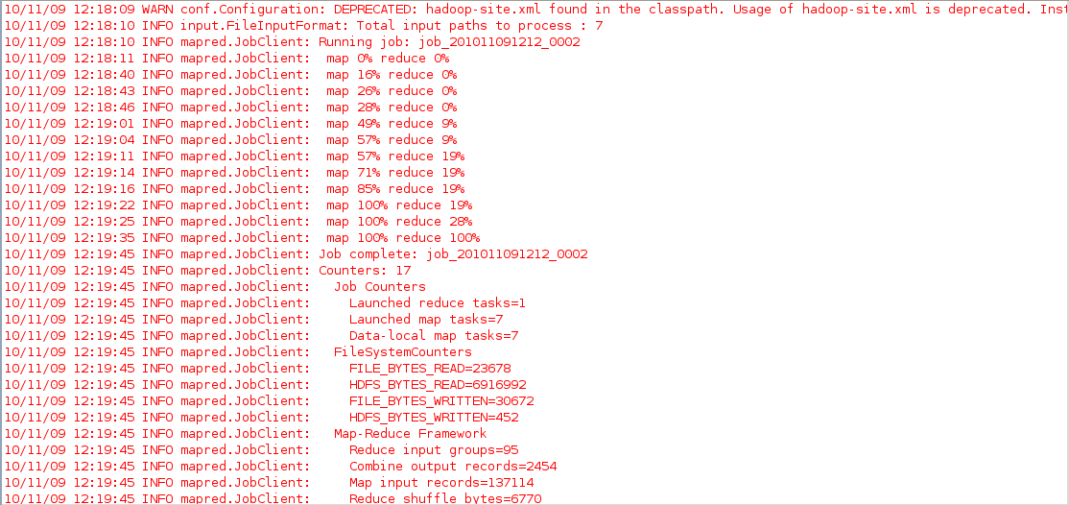
Programming Environment
Without IDE
Using Eclipse

Slide 29
Without IDE
Set CLASSPATH for java compiler.(user: hadoop)
  $ vim ~/.profile
  Relogin
Compile your program(.java files) into .class files
  $ javac <program_name>.java
Run your program on the hadoop (only one class)
  $ bin/hadoop <program_name> <args0> <args1> …

Slide 30
Without IDE (cont.)
Pack your program in a jar file
  jar cvf <jar_name>.jar <program_name>.class
Run your program on the hadoop
  $ bin/hadoop jar <jar_name>. jar <main_fun_name> <args0> <args1> …

Slide 31
Using Eclipse - Step 1
Download the Eclipse 3.7M2a
  $ cd ~
  $ sudo wget http://eclipse.stu.edu.tw/eclipse/downloads/drops/S-3.7M2a-201009211024/download.php?dropFile=eclipse-SDK-3.7M2a-linux-gtk.tar.gz
  $ sudo tar -zxf eclipse-SDK-3.7M2a-linux-gtk.tar.gz
  $ sudo mv eclipse /opt
  $ sudo ln -sf /opt/eclipse/eclipse /usr/local/bin/

Slide 32
Step 2
Put the hadoop-0.20.2 eclipse plugin into the <eclipse_home>/plugin directory
  $ sudo cp <Download path>/hadoop-0.20.2-dev-eclipse-plugin.jar /opt/eclipse/plugin
  Note: <eclipse_home> is the place you installed your eclipse. In our case, it is /opt/eclipse
Setup the xhost and open eclipse with user hadoop
  sudo xhost +SI:localuser:hadoop
  su - hadoop
  eclipse &

Slide 33
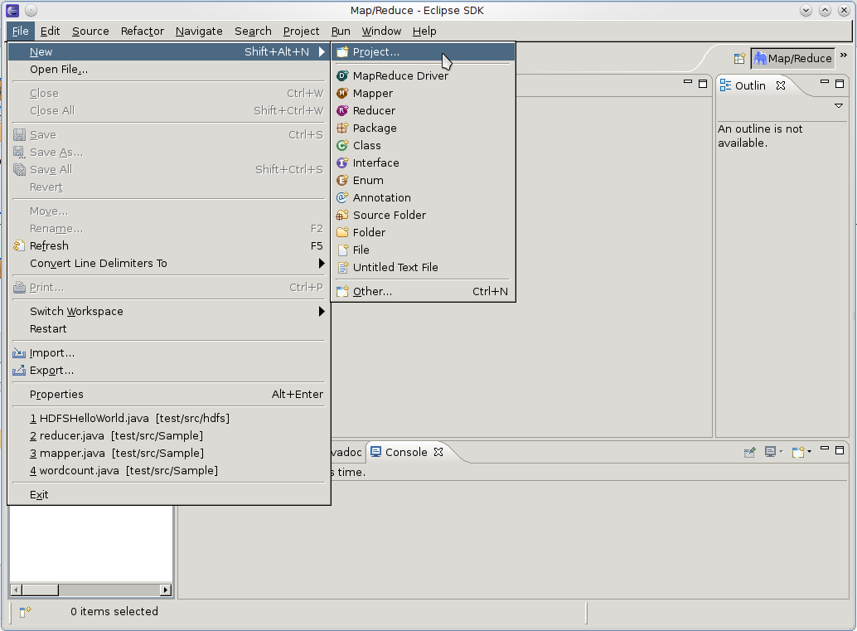
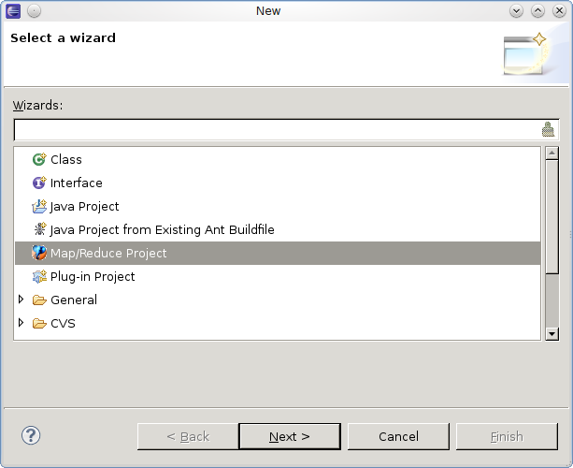
Step 3
New a mapreduce project

Slide 34
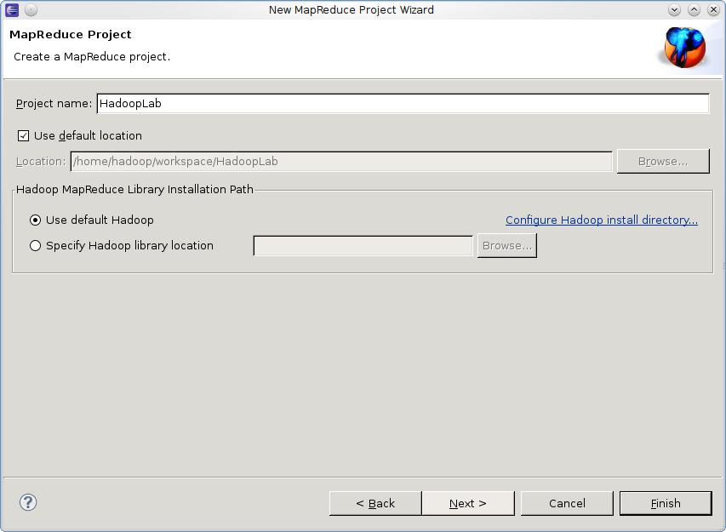
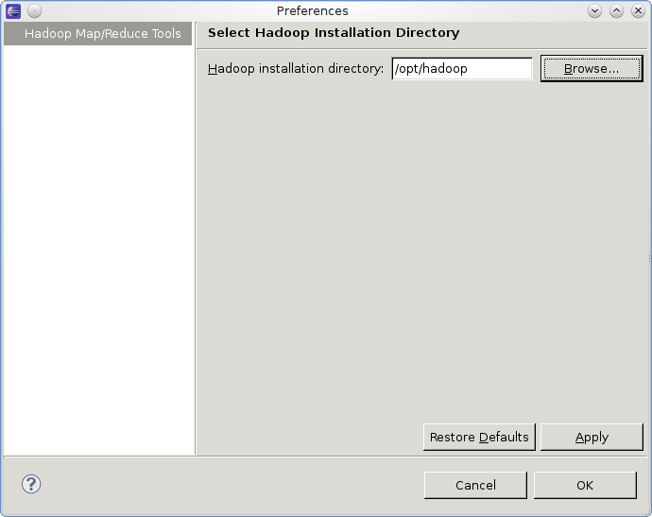
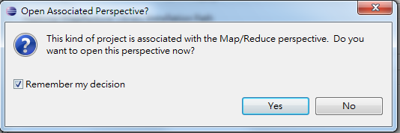
Step 3(cont.)

Slide 35
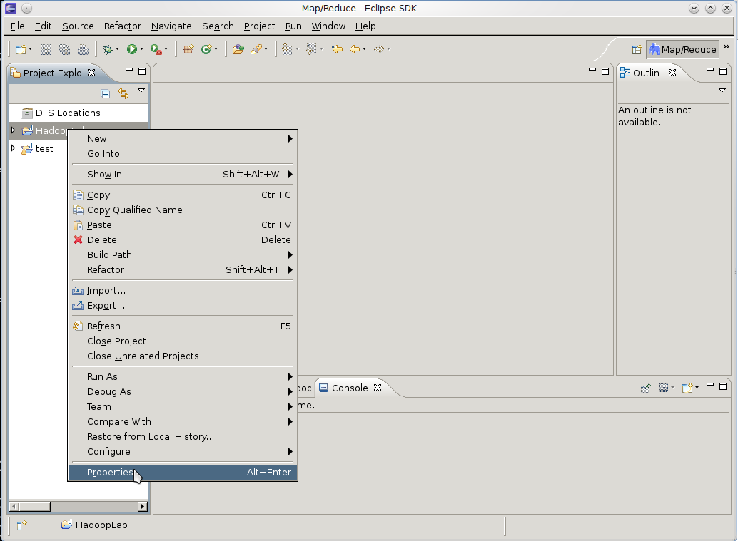
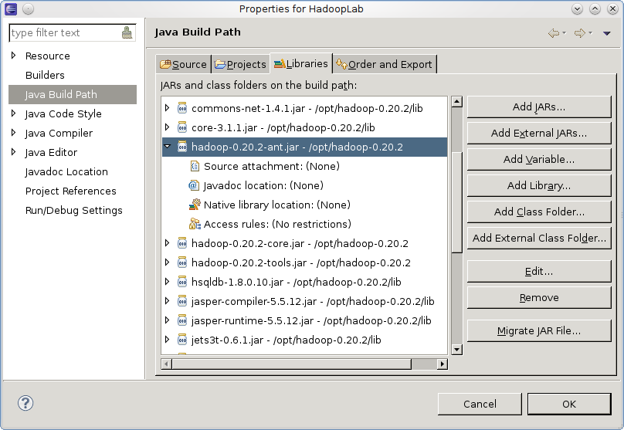
Step 4
Add the library and javadoc path of hadoop

Slide 36
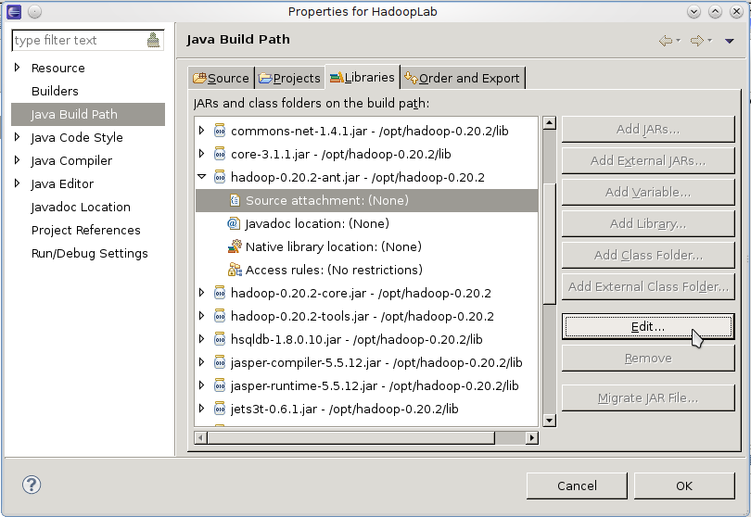
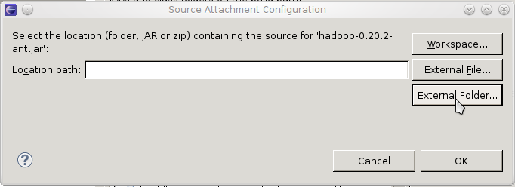
Step 4 (cont.)

Slide 37
Step 4 (cont.)
Set each following path:
  java Build Path -> Libraries -> hadoop-0.20.2-ant.jar
  java Build Path -> Libraries -> hadoop-0.20.2-core.jar
  java Build Path -> Libraries -> hadoop-0.20.2-tools.jar
For example, the setting of hadoop-0.20.2-core.jar:
  source ...->：/opt/opt/hadoop-0.20.2/src/core
  javadoc ...->：file:/opt/hadoop-0.20.2/docs/api/

Slide 38
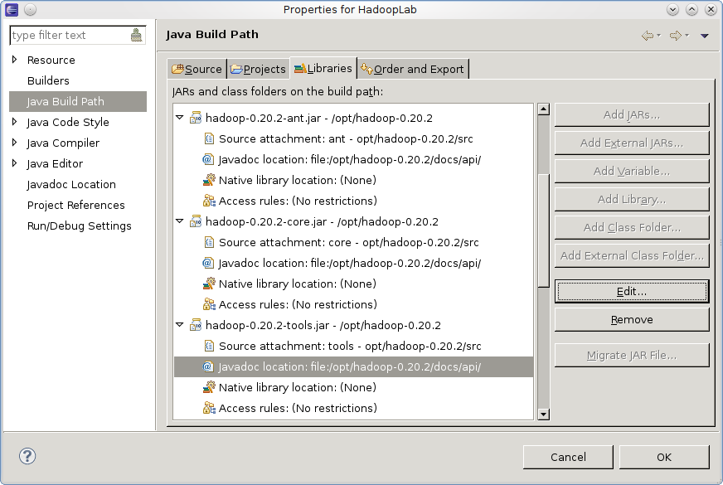
Step 4 (cont.)
After setting …

Slide 39
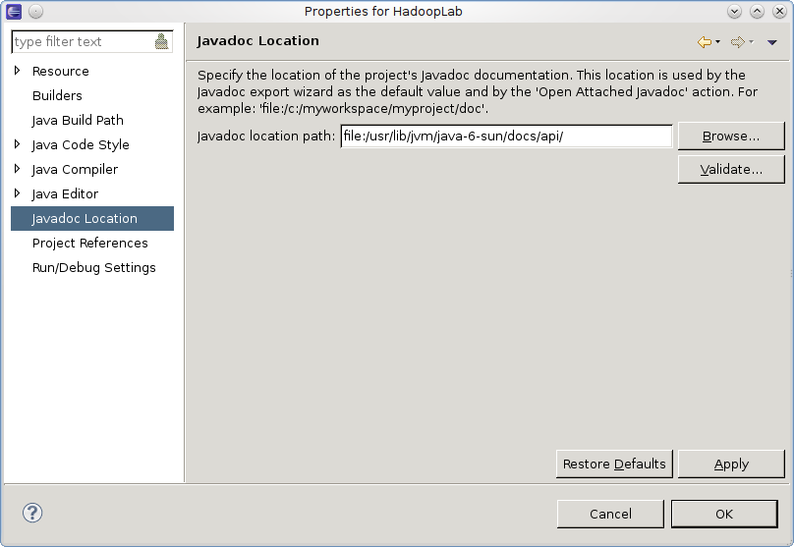
Step 4 (cont.)
Setting the javadoc of java

Slide 40
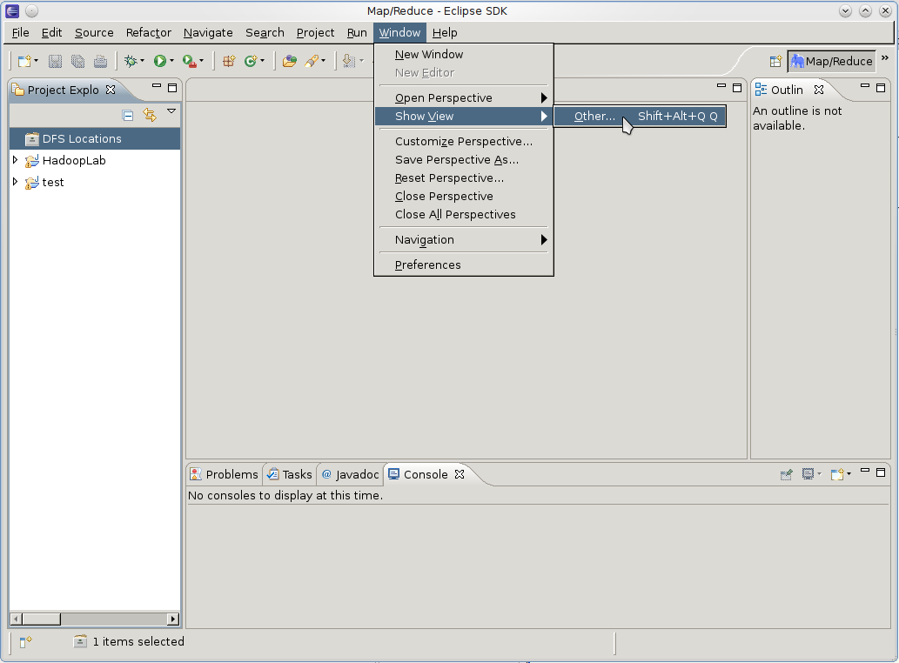
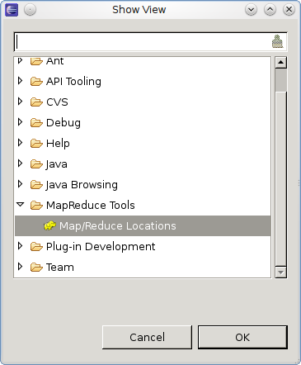
Step 5
Connect to hadoop server

Slide 41
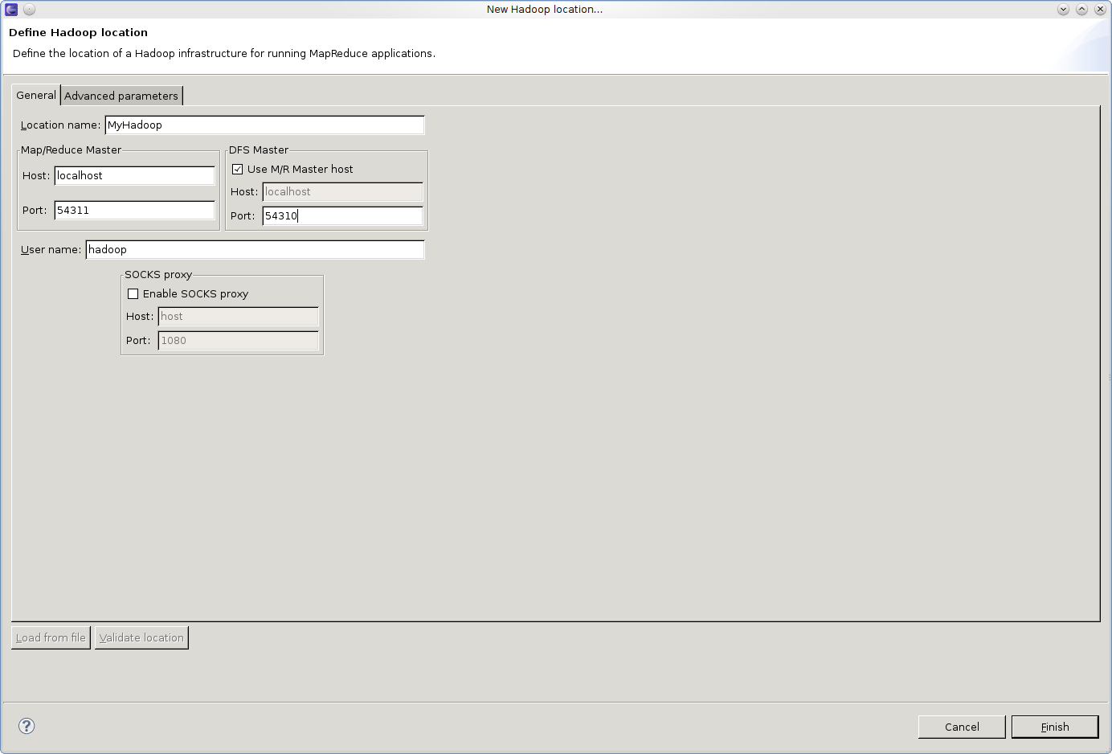
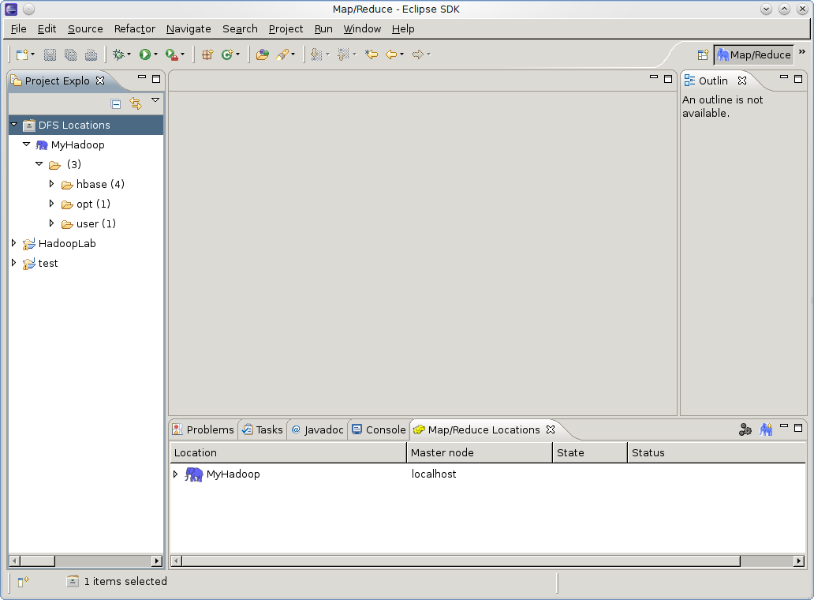
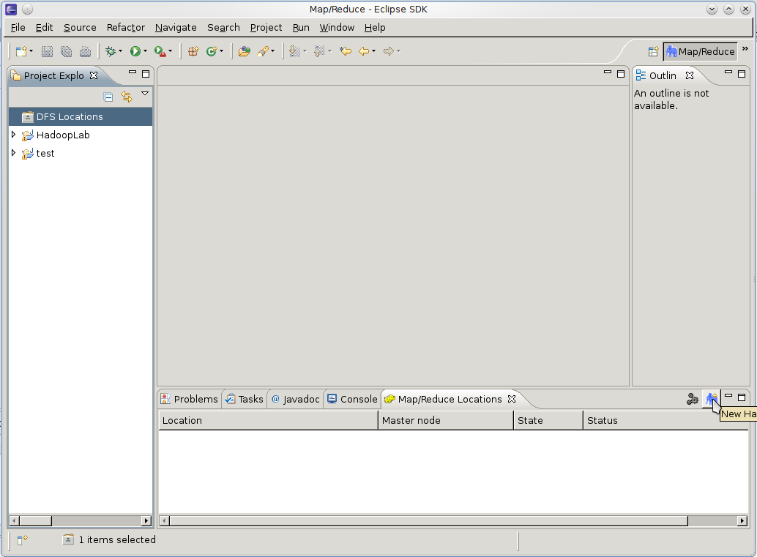
Step 5 (cont.)

Slide 42
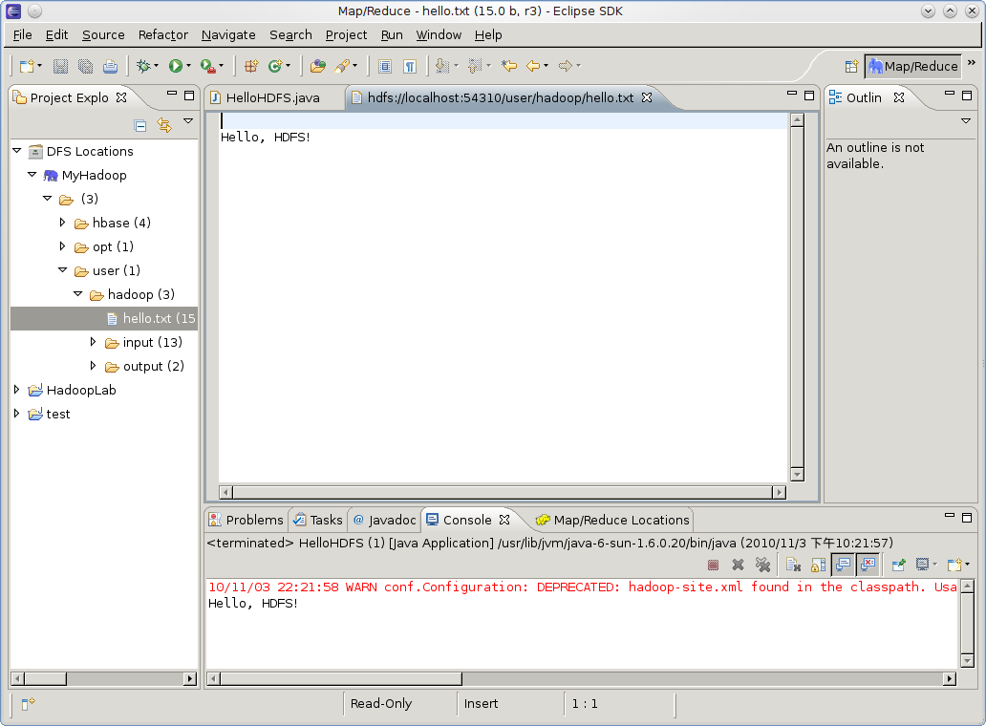
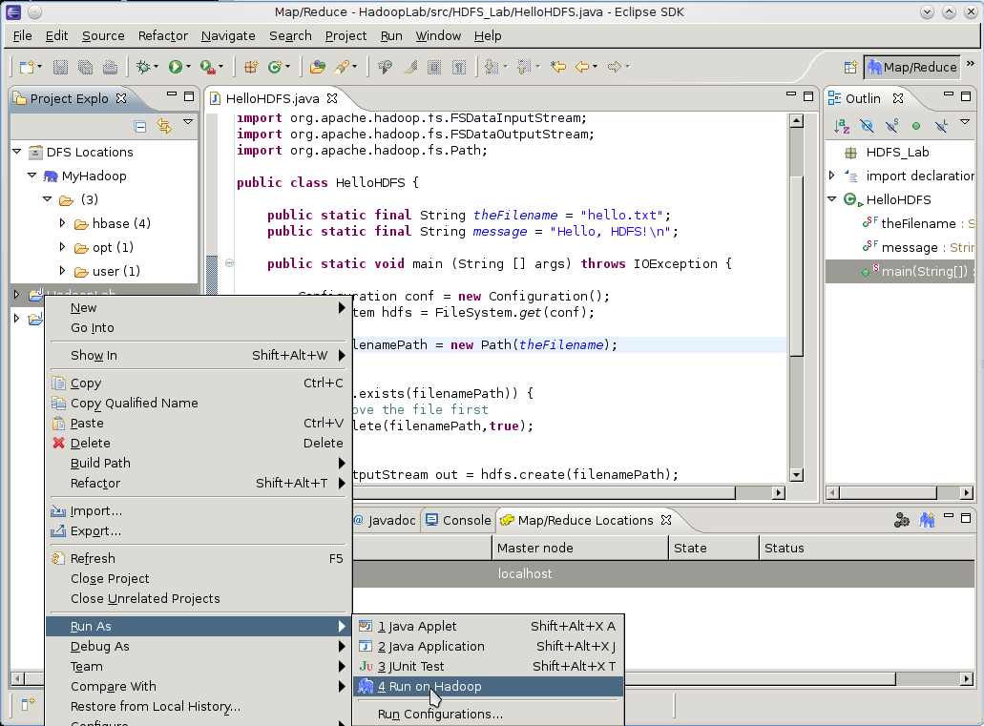
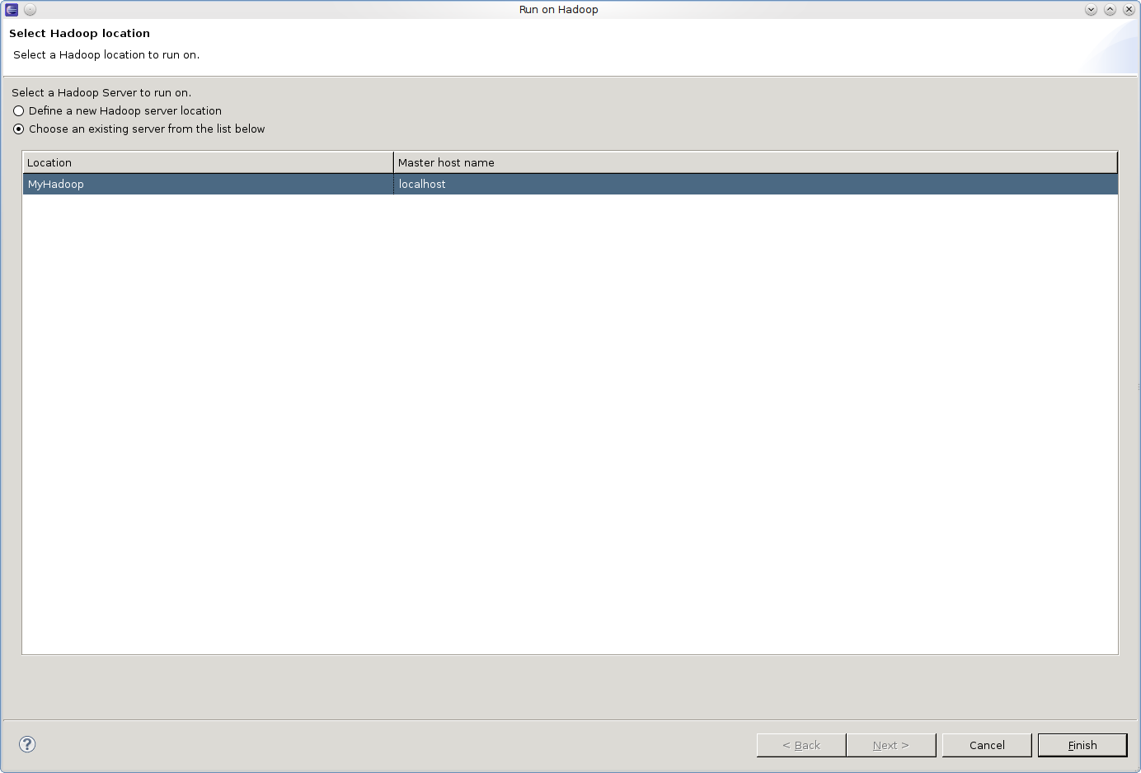
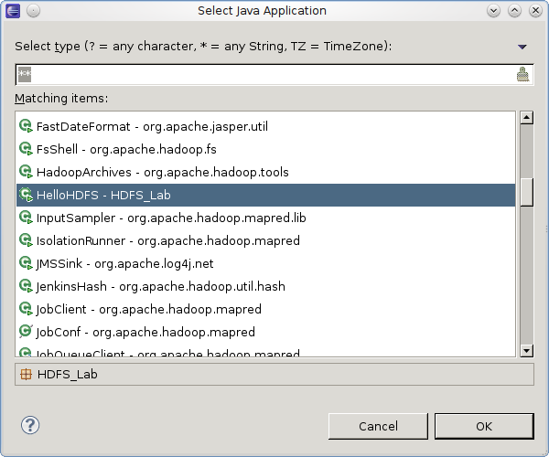
Step 6
Then, you can write programs and run on hadoop with eclipse now.

Slide 43
HDFS
HDFS introduction
HDFS Operations
Programming Environment
Lab Requirement

Slide 44
Requirements
Part I HDFS Shell basic operation (POSIX-like) (5%)
  Create a file named [Student ID] with content “Hello TA, I’m [Student ID].”
  Put it into HDFS.
  Show the content of the file in the HDFS on the screen.
Part II Java Program (using APIs) (25%)
  Write a program to copy the file or directory from HDFS to the local file system. (5%)
  Write a program to get status of a file in the HDFS.(10%)
  Write a program that using Hadoop APIs to do the “ls” operation for listing all files in HDFS. (10%)

Slide 45
Hints
Hadoop setup guide.
Cloud2010_HDFS_Note.docs
Hadoop 0.20.2 API.
  http://hadoop.apache.org/common/docs/r0.20.2/api/
  http://hadoop.apache.org/common/docs/r0.20.2/api/org/apache/hadoop/fs/FileSystem.html

Slide 46
MapReduce
MapReduce Introduction
Sample Code
Program Prototype
Programming using Eclipse
Lab Requirement

Slide 47
What’s MapReduce?
Programming model for expressing distributed computations at a massive scale
A patented software framework introduced by Google
  Processes 20 petabytes of data per day
Popularized by open-source Hadoop project
  Used at Yahoo!, Facebook, Amazon, …
Cloud Applications
MapReduce
Hbase
Hadoop Distributed File System (HDFS)
A Cluster of Machines

Slide 48
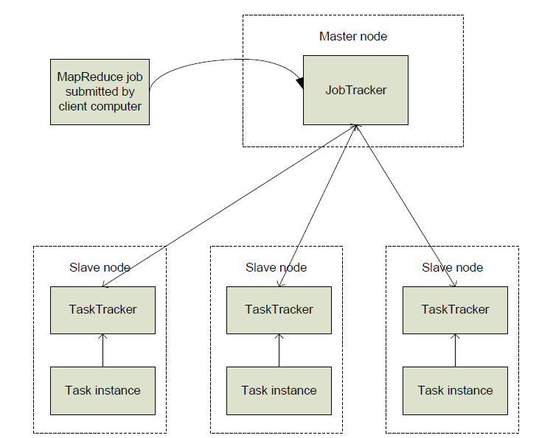
MapReduce: High Level

Slide 49
Nodes, Trackers, Tasks
JobTracker
  Run on Master node
  Accepts Job requests from clients
TaskTracker
  Run on slave nodes
  Forks separate Java process for task instances

Slide 50
Example - Wordcount
Input
Mapper
Sort/Copy
Hello 1
Output
Cloud 1
Merge
Hello Cloud
Reducer
Hello 1
Hello [1 1]
TA [1 1]
Hello 2
TA 2
Hello 1
TA 1
Mapper
TA 1
TA cool
TA 1
cool 1
cool 1
Hello TA
Reducer
Cloud 1
cool 2
Cloud 1
Cloud [1]
cool [1 1]
cool 1
cool 1
Mapper
cool
Hello 1
TA 1

Slide 51
MapReduce
MapReduce Introduction
Sample Code
Program Prototype
Programming using Eclipse
Lab Requirement

Slide 52
Main function
public static void main(String[] args) throws Exception {
Configuration conf = new Configuration();
String[] otherArgs = new GenericOptionsParser(conf, args)
.getRemainingArgs();
if (otherArgs.length != 2) {
System.err.println("Usage: wordcount <in> <out>");
System.exit(2);
}
Job job = new Job(conf, "word count");
job.setJarByClass(wordcount.class);
job.setMapperClass(mymapper.class);
job.setCombinerClass(myreducer.class);
job.setReducerClass(myreducer.class);
FileInputFormat.addInputPath(job, new Path(otherArgs[0]));
FileOutputFormat.setOutputPath(job, new Path(otherArgs[1]));
job.setOutputKeyClass(Text.class);
job.setOutputValueClass(IntWritable.class);
System.exit(job.waitForCompletion(true) ? 0 : 1);
}

Slide 53
Mapper
import java.io.IOException;
import java.util.StringTokenizer;
import org.apache.hadoop.io.IntWritable;
import org.apache.hadoop.io.Text;
import org.apache.hadoop.mapreduce.Mapper;
public class mymapper extends Mapper<Object, Text, Text, IntWritable> {
private final static IntWritable one = new IntWritable(1);
private Text word = new Text();
public void map(Object key, Text value, Context context)
throws IOException, InterruptedException {
String line = ( (Text) value ).toString();
StringTokenizer itr = new StringTokenizer( line);
while (itr.hasMoreTokens()) {
word.set(itr.nextToken());
context.write(word, one);
}
}
}

Slide 54
Mapper(cont.)
Hi Cloud TA say Hi
Input Key
StringTokenizer itr = new StringTokenizer( line);
( (Text) value ).toString();
Hi
Cloud
TA
say
Hi
/user/hadoop/input/hi
…
…
Hi Cloud TA say Hi
…
…
itr
itr
itr
itr
itr
itr
while (itr.hasMoreTokens()) {
word.set(itr.nextToken());
context.write(word, one);
}
<word, one>
Input Value
<Hi, 1>
<Cloud, 1>
<TA, 1>
<say, 1>
<Hi, 1>

Slide 55
Reducer
import java.io.IOException;
import org.apache.hadoop.io.IntWritable;
import org.apache.hadoop.io.Text;
import org.apache.hadoop.mapreduce.Reducer;
public class myreducer extends Reducer<Text, IntWritable, Text, IntWritable> {
private IntWritable result = new IntWritable();
public void reduce(Text key, Iterable<IntWritable> values, Context context)
throws IOException, InterruptedException {
int sum = 0;
for (IntWritable val : values) {
sum += val.get();
}
result.set(sum);
context.write(key, result);
}
}

Slide 56
Reducer (cont.)
<word, one>
<Hi, 1 → 1>
<Cloud, 1>
<TA, 1>
Hi
<say, 1>
1
1
<key, result>
<Hi, 2>
<Cloud, 1>
<TA, 1>
<say, 1>

Slide 57
MapReduce
MapReduce Introduction
Sample Code
Program Prototype
Programming using Eclipse
Lab Requirement

Slide 58
Some MapReduce Terminology
Job
  A “full program” - an execution of a Mapper and Reducer across a data set
Task
  An execution of a Mapper or a Reducer on a slice of data
Task Attempt
  A particular instance of an attempt to execute a task on a machine

Slide 59
Main Class
Class MR{
main(){
Configuration conf = new Configuration();
Job job = new Job(conf, “job name");
job.setJarByClass(thisMainClass.class);
job.setMapperClass(Mapper.class);
job.setReduceClass(Reducer.class);
FileInputFormat.addInputPaths(job, new Path(args[0]));
FileOutputFormat.setOutputPath(job, new Path(args[1]));
job.waitForCompletion(true);
}
}

Slide 60
Job
Identify classes implementing Mapper and Reducer interfaces
  Job.setMapperClass(), setReducerClass()
Specify inputs, outputs
  FileInputFormat.addInputPath()
  FileOutputFormat.setOutputPath()
Optionally, other options too:
  Job.setNumReduceTasks(),
  Job.setOutputFormat()…

Slide 61
Class Mapper
Class Mapper<KEYIN,VALUEIN,KEYOUT,VALUEOUT>
  Maps input key/value pairs to a set of intermediate key/value pairs.
Ex:
Class MyMapper extend Mapper <Object, Text, Text, IntWritable>
{
//global variable
public void map(Object key, Text value, Context context)
throws IOException,InterruptedException
{
//local vaiable
….
context.write(key’, value’);
}
}
Input Class(key, value)
Onput Class(key, value)

Slide 62
Text, IntWritable, LongWritable,
Hadoop defines its own “box” classes
  Strings : Text
  Integers : IntWritable
  Long : LongWritable
Any (WritableComparable, Writable) can be sent to the reducer
  All keys are instances of WritableComparable
  All values are instances of Writable

Slide 63
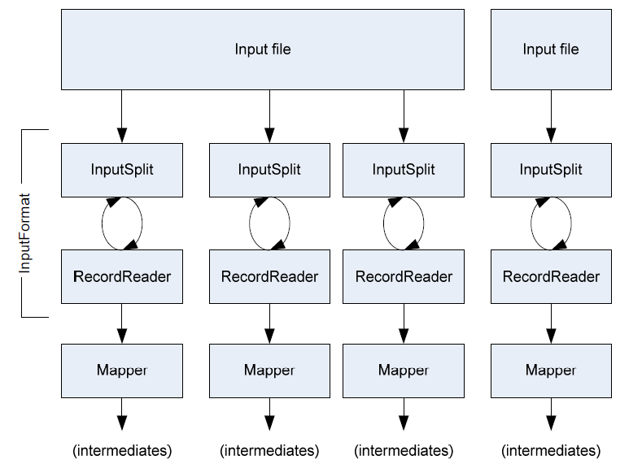
Read Data

Slide 64
Mappers
Upper-case Mapper
  Ex: let map(k, v) = emit(k.toUpper(), v.toUpper())
    (“foo”, “bar”) → (“FOO”, “BAR”)
    (“Foo”, “other”) → (“FOO”, “OTHER”)
    (“key2”, “data”) → (“KEY2”, “DATA”)
Explode Mapper
  let map(k, v) = for each char c in v: emit(k, c)
    (“A”, “cats”) → (“A”, “c”), (“A”, “a”), (“A”, “t”), (“A”, “s”)
    (“B”, “hi”) → (“B”, “h”), (“B”, “i”)
Filter Mapper
  let map(k, v) = if (isPrime(v)) then emit(k, v)
    (“foo”, 7) → (“foo”, 7)
    (“test”, 10) → (nothing)

Slide 65
Class Reducer
Class Reducer<KEYIN,VALUEIN,KEYOUT,VALUEOUT>
  Reduces a set of intermediate values which share a key to a smaller set of values.
Ex:
Class MyReducer extend Reducer < Text, IntWritable, Text, IntWritable>
{
//global variable
public void reduce(Object key, Iterable<IntWritable> value, Context context)
throws IOException,InterruptedException
{
//local vaiable
….
context.write(key’, value’);
}
}
Input Class(key, value)
Onput Class(key, value)

Slide 66
Reducers
Sum Reducer
  (“A”, [42, 100, 312]) → (“A”, 454)
Identity Reducer
  (“A”, [42, 100, 312]) → (“A”, 42),(“A”, 100), (“A”, 312)
let reduce(k, vals) =
sum = 0
foreach int v in vals:
sum += v
emit(k, sum)
let reduce(k, vals) =
foreach v in vals:
emit(k, v)

Slide 67
Performance Consideration
Ideal scaling characteristics:
  Twice the data, twice the running time
  Twice the resources, half the running time
Why can’t we achieve this?
  Synchronization requires communication
  Communication kills performance
Thus… avoid communication!
  Reduce intermediate data via local aggregation
  Combiners can help

Slide 68
k₁
v₁
k₂
v₂
k₃
v₃
k₄
v₄
k₅
v₅
k₆
v₆
map
map
map
map
a
1
b
2
c
3
c
6
a
5
c
2
b
7
c
8
combine
combine
combine
combine
a
1
b
2
c
9
a
5
c
2
b
7
c
8
partition
partition
partition
partition
Shuffle and Sort: aggregate values by keys
a
1
5
b
2
7
c
2
9
8
reduce
reduce
reduce
r₁
s₁
r₂
s₂
r₃
s₃

Slide 69
MapReduce
MapReduce Introduction
Sample Code
Program Prototype
Programming using Eclipse
Lab Requirement

Slide 70
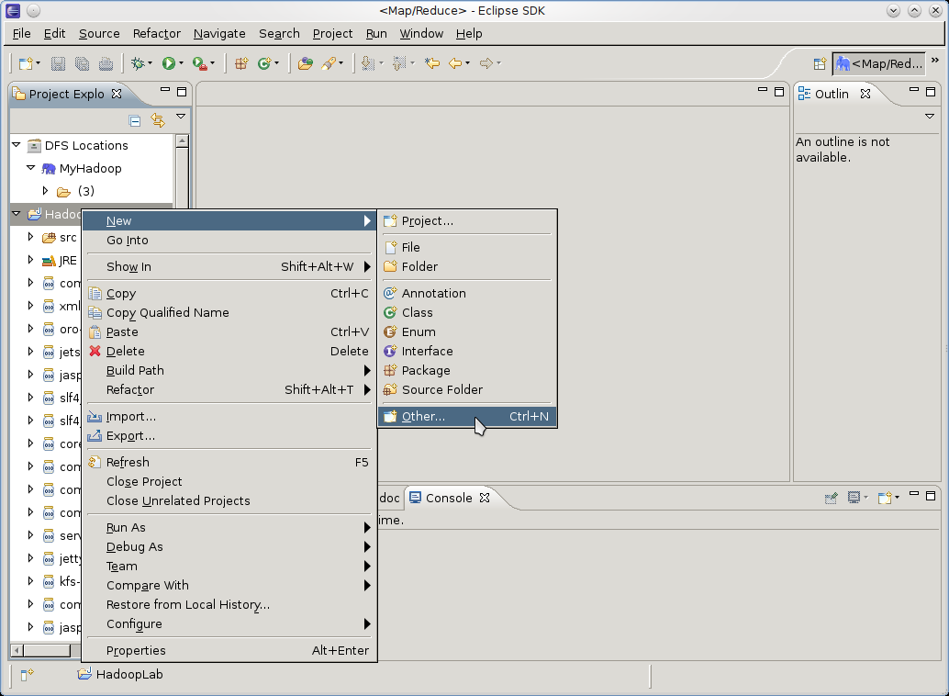
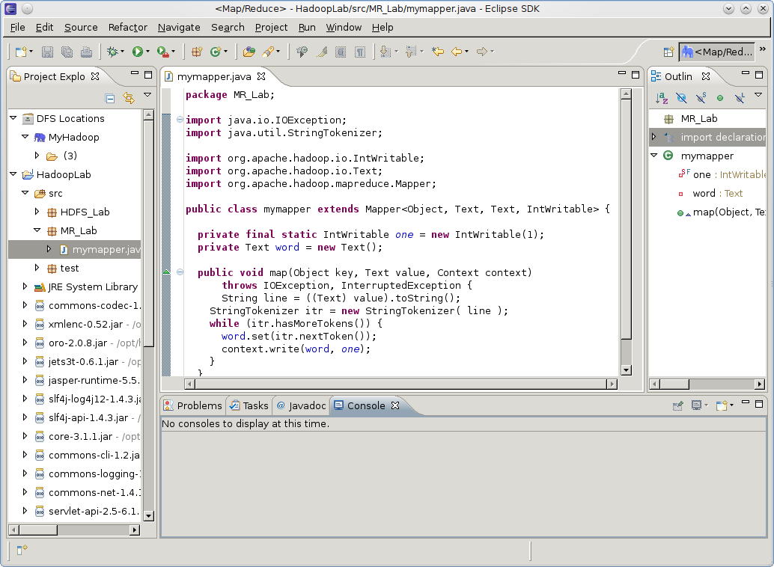
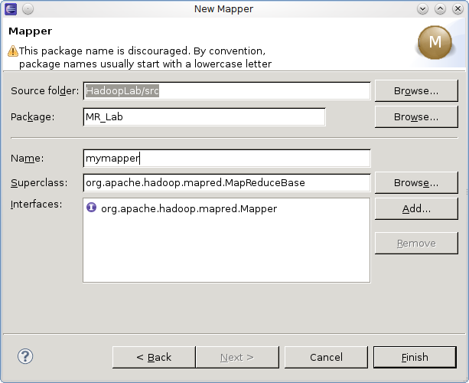
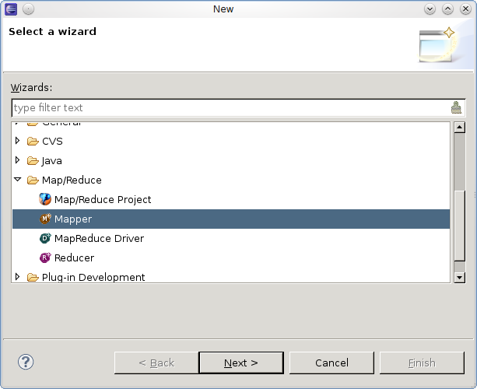
MR package, Mapper Class

Slide 71
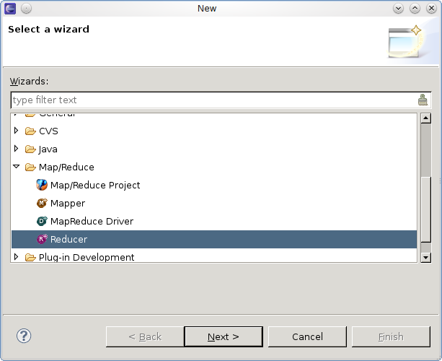
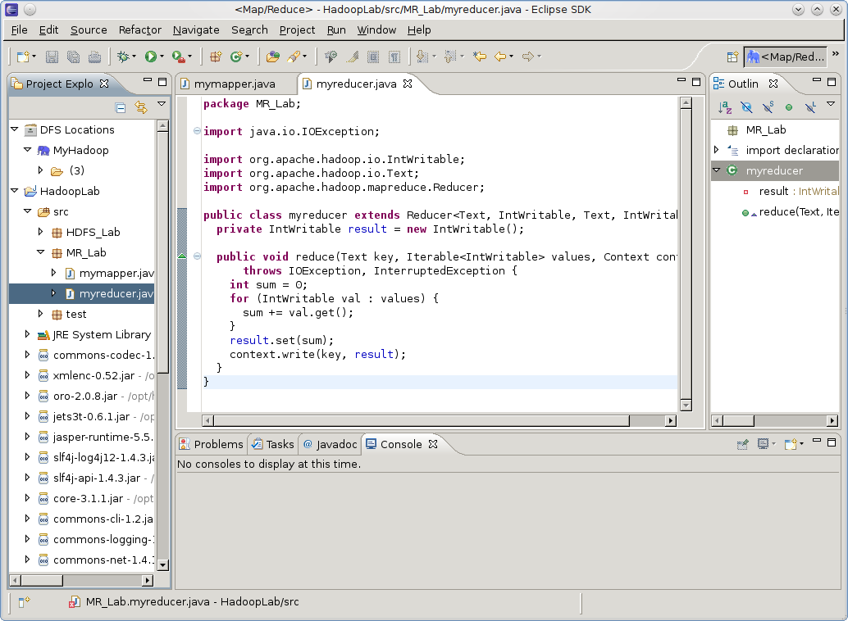
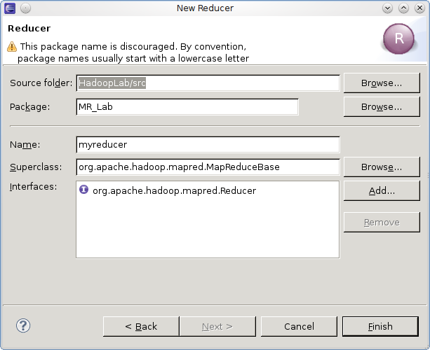
Reducer Class

Slide 72
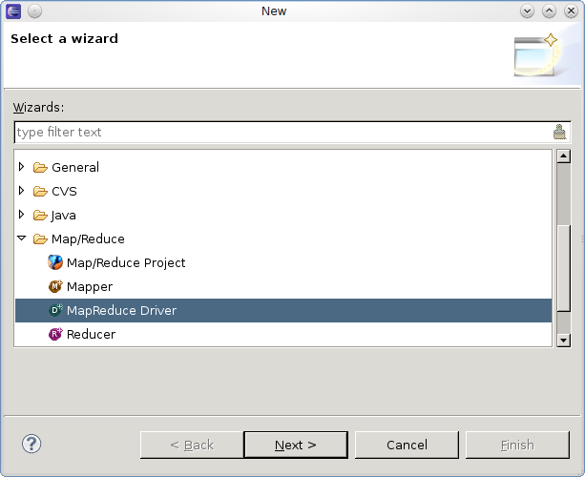
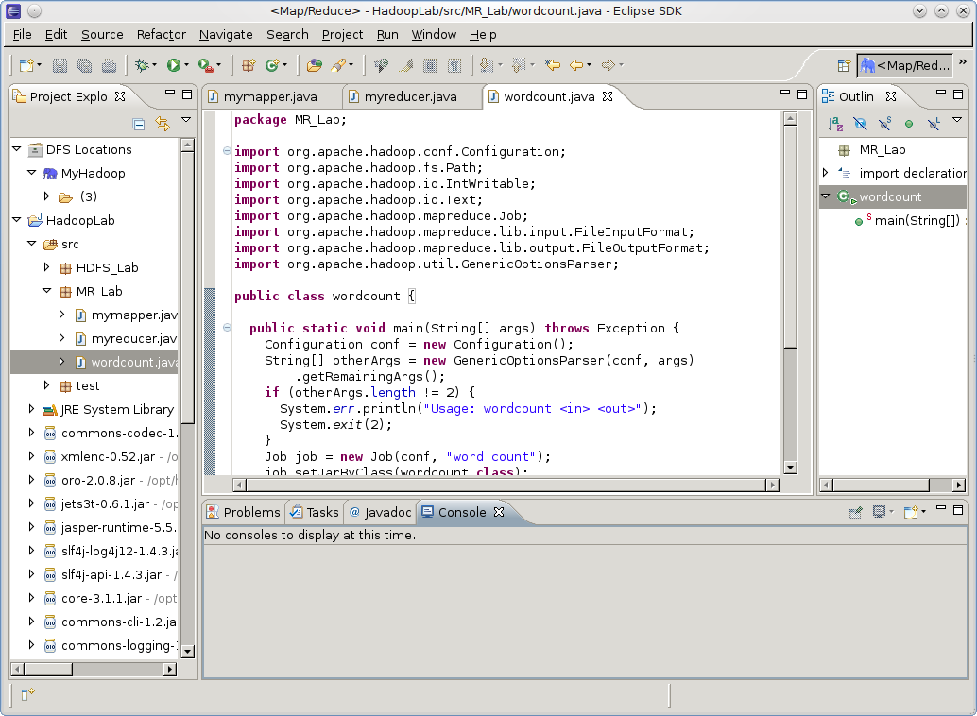
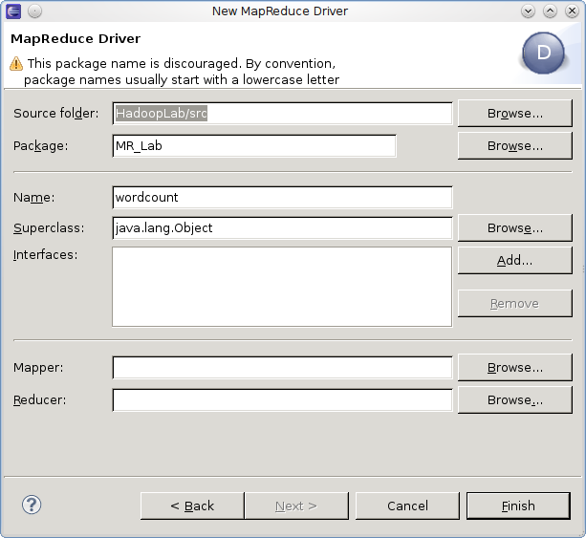
MR Driver(Main class)

Slide 73
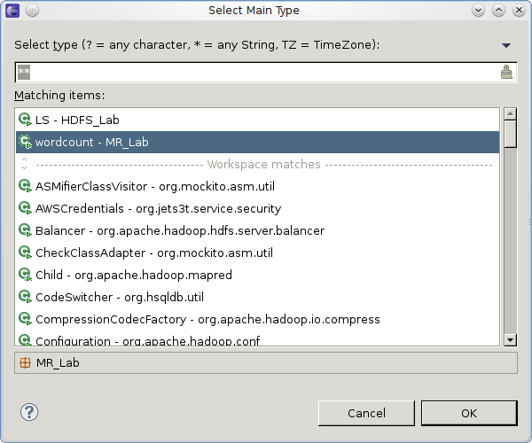
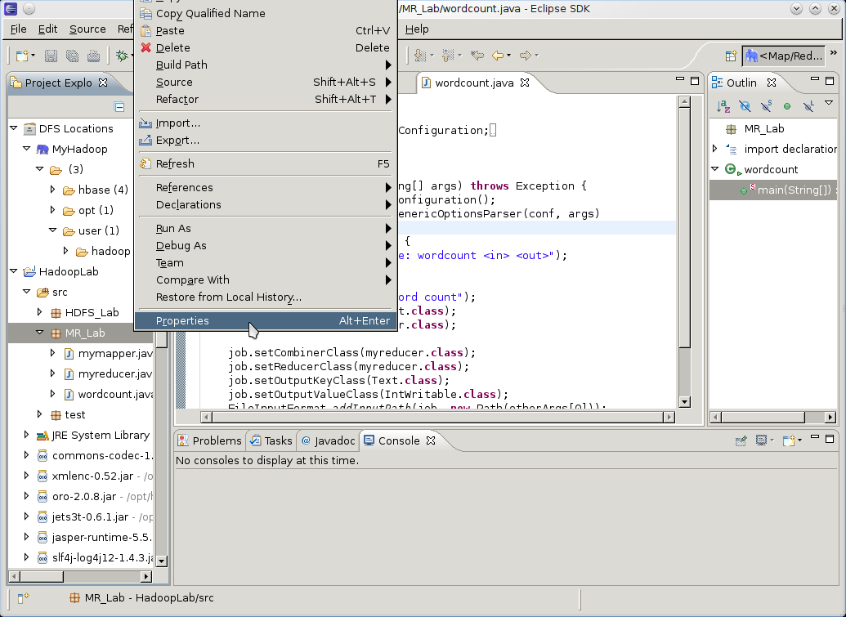
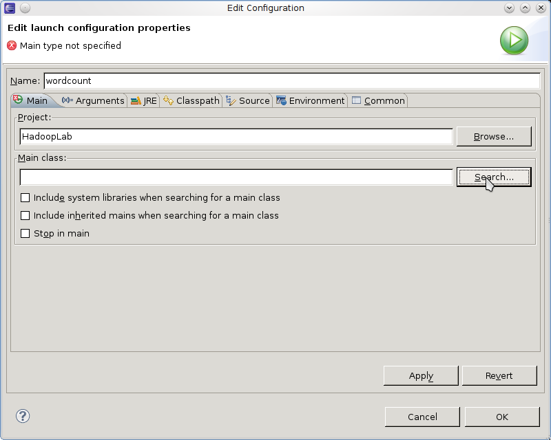
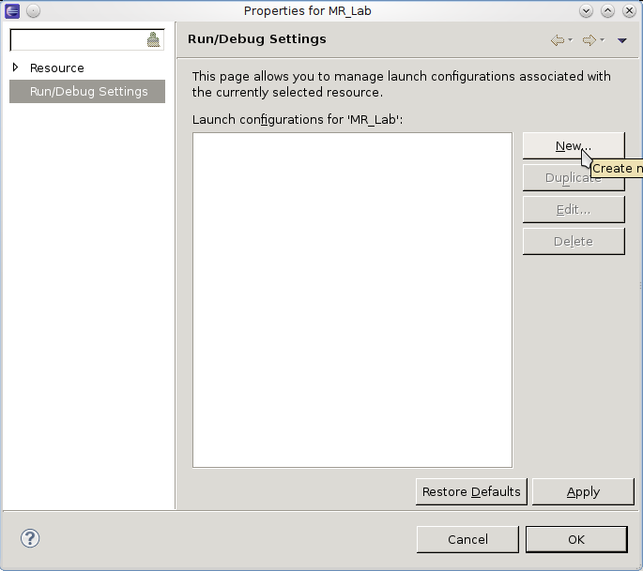
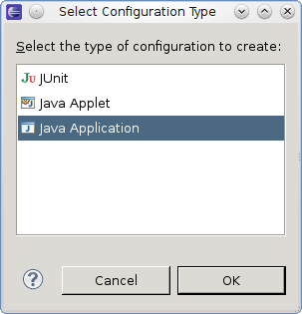
Run on hadoop

Slide 74
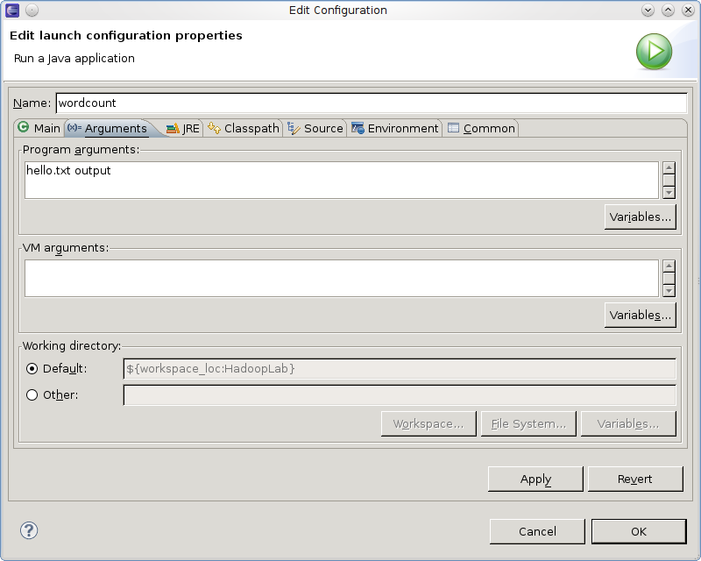
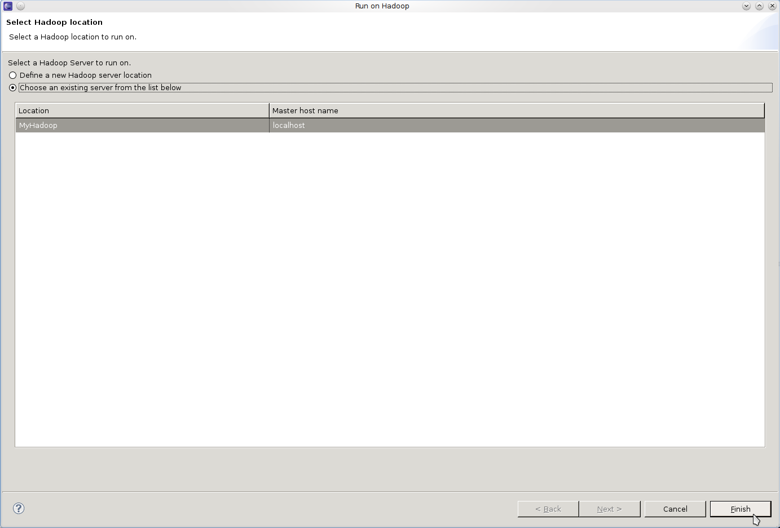
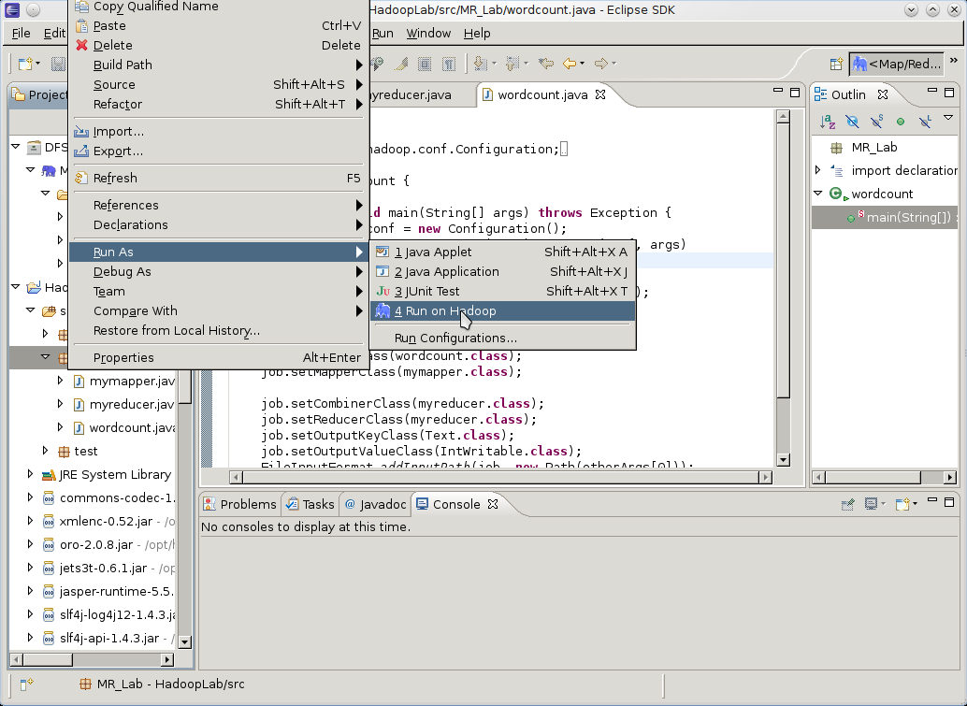
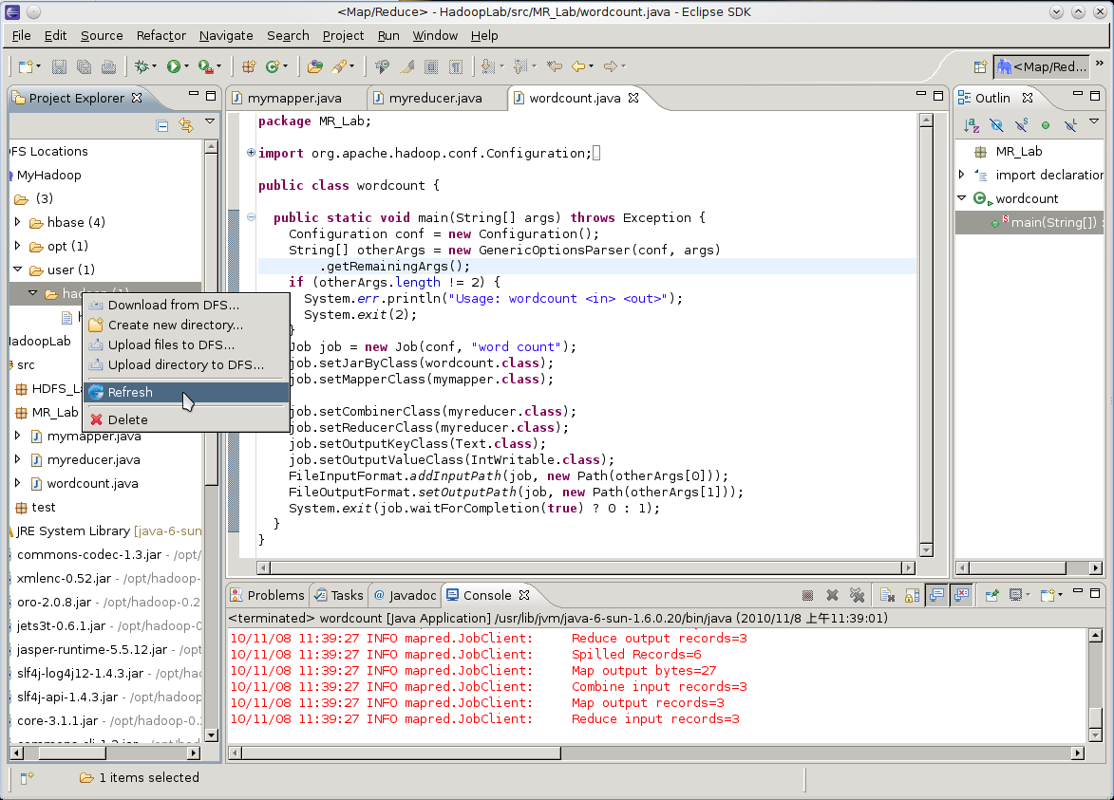
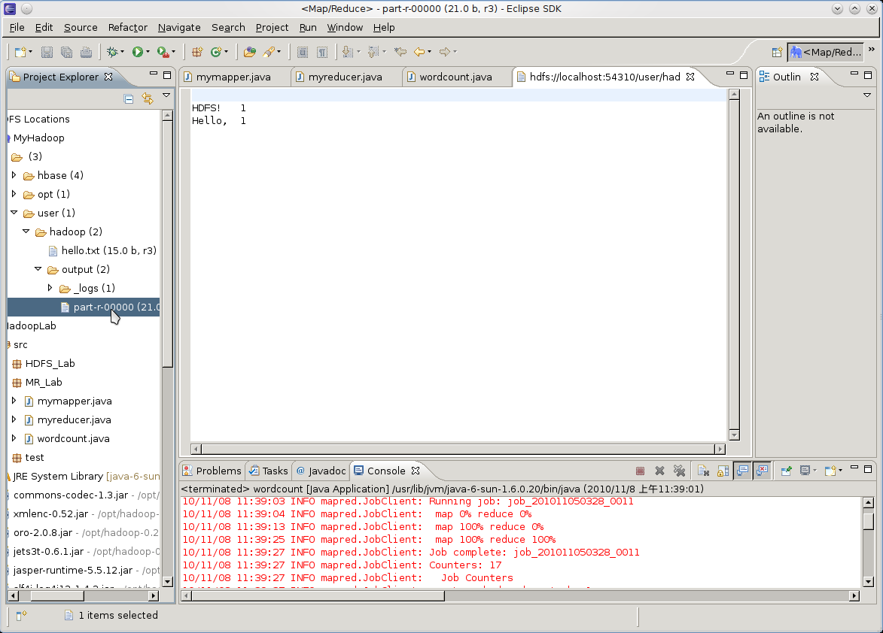
Run on hadoop(cont.)

Slide 75
MapReduce
MapReduce Introduction
Program Prototype
An Example
Programming using Eclipse
Lab Requirement

Slide 76
Requirements
Part I Modify the given example: WordCount (10%*3)
  Main function – add an argument to allow user to assign the number of Reducers.
  Mapper – Change WordCount to CharacterCount (except “ ”)
  Reducer – Output those characters that occur >= 1000 times
Part II (10%)
  After you finish part I, SORT the output of part I according to the number of times
    using the mapreduce programming model.

Slide 77
Hint
Hadoop 0.20.2 API.
  http://hadoop.apache.org/common/docs/r0.20.2/api/
  http://hadoop.apache.org/common/docs/r0.20.2/api/org/apache/hadoop/mapreduce/InputFormat.html
In the Part II, you may not need to use both mapper and reducer. (The output keys of mapper are sorted.)

Slide 78
HBase
Hbase Introduction
Basic Operations
Common APIs
Programming Environment
Lab Requirement

Slide 79
What’s Hbase?
Distributed Database modeled on column-oriented rows
Scalable data store
Apache Hadoop subproject since 2008
Cloud Applications
MapReduce
Hbase
Hadoop Distributed File System (HDFS)
A Cluster of Machines

Slide 80
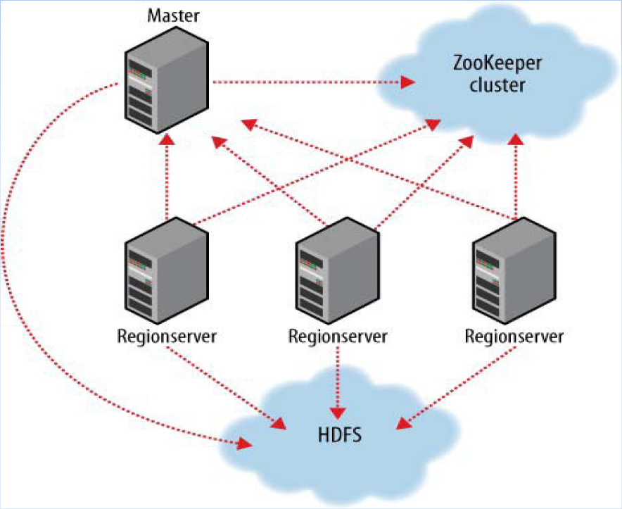
Hbase Architecture

Slide 81
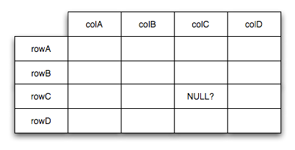
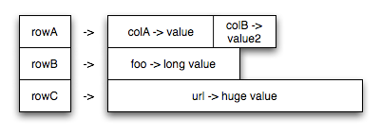
Data Model

Slide 82
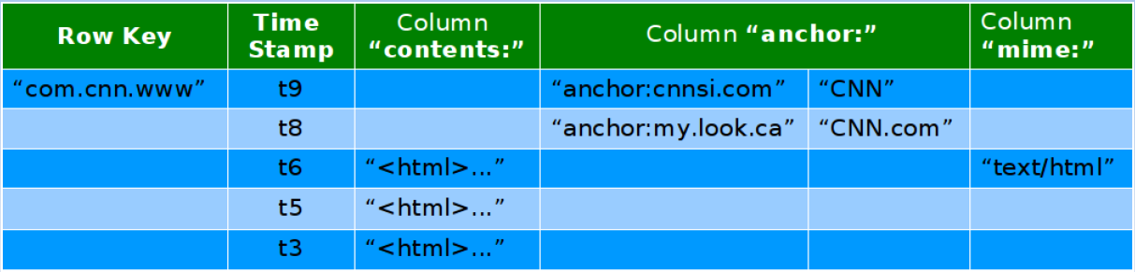
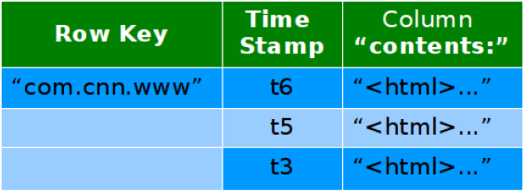


Example
Conceptual View
Physical Storage View

Slide 83
HBase
Hbase Introduction
Basic Operations
Common APIs
Programming Environment
Lab Requirement

Slide 84
Basic Operations
Create a table
Put data into column
Get column value
Scan all column
Delete a table

Slide 85
Create a table(1/2)
In the Hbase shell – at the path <HBASE_HOME>
  $ bin/hbase shell
  > create “Tablename”,” CloumnFamily0”, ”CloumnFamily1”,…
    Ex:
  > list
    Ex:

Slide 86
Create a table(2/2)
public static void createHBaseTable(String tablename, String family)
throws IOException {
HTableDescriptor htd = new HTableDescriptor(tablename);
htd.addFamily(new HColumnDescriptor(family));
HBaseConfiguration config = new HBaseConfiguration();
HBaseAdmin admin = new HBaseAdmin(config);
if (admin.tableExists(tablename)) {
System.out.println("Table: " + tablename + "Existed.");
} else {
System.out.println("create new table: " + tablename);
admin.createTable(htd);
}
}

Slide 87

Put data into column(1/2)
In the Hbase shell
  > put “Tablename",“row",“column: qualifier ",“value“
    Ex:

Slide 88
Put data into column(2/2)
static public void putData(String tablename, String row, String family,
String qualifier, String value) throws IOException {
HBaseConfiguration config = new HBaseConfiguration();
HTable table = new HTable(config, tablename);
byte[] brow = Bytes.toBytes(row);
byte[] bfamily = Bytes.toBytes(family);
byte[] b qualifier = Bytes.toBytes(qualifier);
byte[] bvalue = Bytes.toBytes(value);
Put p = new Put(brow);
p.add(bfamily, bqualifier, bvalue);
table.put(p);
System.out.println("Put data :\"" + value + "\" to Table: " + tablename + "'s " + family + ":" + qualifier);
table.close();
}

Slide 89

Get column value(1/2)
In the Hbase shell
  >get “Tablename”,”row”
    Ex:

Slide 90
Get column value(2/2)
static String getColumn(String tablename, String row, String family,
String qualifier) throws IOException {
HBaseConfiguration config = new HBaseConfiguration();
HTable table = new HTable(config, tablename);
String ret = "";
try {
Get g = new Get(Bytes.toBytes(row));
Result rowResult = table.get(g);
ret = Bytes.toString(rowResult.getValue(Bytes.toBytes(family + ":"+ qualifier)));
table.close();
} catch (IOException e) {
e.printStackTrace();
}
return ret;
}

Slide 91

Scan all column(1/2)
In the Hbase shell
  > scan “Tablename”
    Ex:

Slide 92
Scan all column(2/2)
static void ScanColumn(String tablename, String family, String column) {
HBaseConfiguration conf = new HBaseConfiguration();
HTable table;
try {
table = new HTable(conf, Bytes.toBytes(tablename));
ResultScanner scanner = table.getScanner(Bytes.toBytes(family));
System.out.println("Scan the Table [" + tablename + "]'s Column => " + family + ":" + column);
int i = 1;
for (Result rowResult : scanner) {
byte[] by = rowResult.getValue(Bytes.toBytes(family), Bytes.toBytes(column));
String str = Bytes.toString(by);
System.out.println("row " + i + " is \"" + str + "\"");
i++;
}
} catch (IOException e) {
e.printStackTrace();
}
}

Slide 93
Delete a table
In the Hbase shell
  > disable “Tablename”
  > drop “Tablename”
    Ex: > disable “SSLab”
    > drop “SSLab”

Slide 94
HBase
Hbase Introduction
Basic Operations
Common APIs
Programming Environment
Lab Requirement

Slide 95
Useful APIs
HBaseConfiguration
HBaseAdmin
HTable
HTableDescriptor
Put
Get
Scan

Slide 96
HBaseConfiguration
Adds HBase configuration files to a Configuration.
  HBaseConfiguration conf = new HBaseConfiguration ( )
    A new configuration
Inherit from org.apache.hadoop.conf.Configuration
Return type | Function | Parameter
void | addResource | (Path file)
void | clear | ( )
String | get | (String name)
void | set | (String name, String value)

Slide 97
HBaseAdmin
Provides administrative functions for HBase.
  … = new HBaseAdmin( HBaseConfiguration conf )
Ex:
HBaseAdmin admin = new HBaseAdmin(config);
admin.disableTable (“tablename”);
Return type | Function | Parameter
void | createTable | (HTableDescriptor desc)
void | addColumn | (String tableName, HColumnDescriptor column)
void | enableTable | (byte[] tableName)
HTableDescriptor[] | listTables | ()
void | modifyTable | (byte[] tableName, HTableDescriptor htd)
boolean | tableExists | (String tableName)

Slide 98
HTableDescriptor
HTableDescriptor contains the name of an HTable, and its column families.
  … = new HTableDescriptor(String name)
Ex:
HTableDescriptor htd = new HTableDescriptor(tablename);
htd.addFamily ( new HColumnDescriptor (“Family”));
Return type | Function | Parameter
void | addFamily | (HColumnDescriptor family)
HColumnDescriptor | removeFamily | (byte[] column)
byte[] | getName | ( )
byte[] | getValue | (byte[] key)
void | setValue | (String key, String value)

Slide 99
HTable
Used to communicate with a single HBase table.
  …= new HTable(HBaseConfiguration conf, String tableName)
Ex:
HTable table = new HTable (conf, SSLab);
ResultScanner scanner = table.getScanner ( family );
Return type | Function | Parameter
void | close | ()
boolean | exists | (Get get)
Result | get | (Get get)
ResultScanner | getScanner | (byte[] family)
void | put | (Put put)

Slide 100
Put
Used to perform Put operations for a single row.
  … = new Put(byte[] row)
Ex:
HTable table = new HTable (conf, Bytes.toBytes ( tablename ));
Put p = new Put ( brow );
p.add (family, qualifier, value);
table.put ( p );
Return type | Function | Parameter
Put | add | (byte[] family, byte[] qualifier, byte[] value)
byte[] | getRow | ()
long | getTimeStamp | ()
boolean | isEmpty | ()

Slide 101
Get
Used to perform Get operations on a single row.
  … = new Get (byte[] row)
Ex:
HTable table = new HTable(conf, Bytes.toBytes(tablename));
Get g = new Get(Bytes.toBytes(row));
Return type | Function | Parameter
Get | addColumn | (byte[] column)
Get | addColumn | (byte[] family, byte[] qualifier)
Get | addFamily | (byte[] family)
Get | setTimeRange | (long minStamp, long maxStamp)

Slide 102
Result
Single row result of a Get or Scan query.
  … = new Result()
Ex:
HTable table = new HTable(conf, Bytes.toBytes(tablename));
Get g = new Get(Bytes.toBytes(row));
Result rowResult = table.get(g);
Bytes[] ret = rowResult.getValue( (family + ":"+ column ) );
Return type | Function | Parameter
byte[] | getValue | (byte[] column)
byte[] | getValue | (byte[] family, byte[] qualifier)
boolean | isEmpty | ( )
String | toString | ( )

Slide 103
Scan
Used to perform Scan operations.
All operations are identical to Get.
  Rather than specifying a single row, an optional startRow and stopRow may be defined.
    = new Scan (byte[] startRow, byte[] stopRow)
  If rows are not specified, the Scanner will iterate over all rows.
    = new Scan ()

Slide 104
ResultScanner
Interface for client-side scanning. Go to HTable to obtain instances.
  table.getScanner (Bytes.toBytes(family));
Ex:
ResultScanner scanner = table.getScanner (Bytes.toBytes(family));
for (Result rowResult : scanner) {
Bytes[] str = rowResult.getValue ( family , column );
}
Return type | Function | Parameter
void | close | ( )
void | sync | ( )

Slide 105
HBase
Hbase Introduction
Basic Operations
Useful APIs
Programming Environment
Lab Requirement

Slide 106
Configuration(1/2)
Modify the .profile in the user: hadoop home directory.
  $ vim ~/.profile
  Relogin
Modify the parameter HADOOP_CLASSPATH in the hadoop-env.sh
  vim /opt/hadoop/conf/hadoop-env.sh

Slide 107
Configuration(2/2)
Set Hbase settings links to hadoop
  $ ln -s /opt/hbase/lib/* /opt/hadoop/lib/
  $ ln -s /opt/hbase/conf/* /opt/hadoop/conf/
  $ ln -s /opt/hbase/bin/* /opt/hadoop/bin/

Slide 108
Compile & run without Eclipse
Compile your program
  cd /opt/hadoop/
  $ javac <program_name>.java
Run your program
  $ bin/hadoop <program_name>

Slide 109




With Eclipse

Slide 110
HBase
Hbase Introduction
Basic Operations
Useful APIs
Programming Environment
Lab Requirement

Slide 111
Requirements
Part I (15%)
  Complete the “Scan all column” functionality.
Part II (15%)
  Change the output of the Part I in MapReduce Lab to Hbase.
  That is, use the mapreduce programming model to output those characters (un-sorted) that occur >= 1000 times, and then output the results to Hbase.

Slide 112
Hint
Hbase Setup Guide.docx
Hbase 0.20.6 APIs
  http://hbase.apache.org/docs/current/api/index.html
  http://hbase.apache.org/docs/current/api/org/apache/hadoop/hbase/package-frame.html
  http://hbase.apache.org/docs/current/api/org/apache/hadoop/hbase/client/package-frame.html

Slide 113
Reference
University of MARYLAND – Cloud course of Jimmy Lin
  http://www.umiacs.umd.edu/~jimmylin/cloud-2010-Spring/index.html
NCHC Cloud Computing Research Group
  http://trac.nchc.org.tw/cloud
Cloudera - Hadoop Training and Certification
  http://www.cloudera.com/hadoop-training/

Slide 114
What You Have to Hand-In
Hard-Copy Report
  Lesson learned
  The screenshot, including the HDFS Part I
  The outstanding work you did
Source Codes and a jar package contain all classes and ReadMe file(How to run your program)
  HDFS
    Part II
  MR
    Part I
    Part II
  Hbase
    Part I
    Part II
Note:
CANNOT run your program will get 0 point
No LATE is allowed

